Slide 1

CROWDSTRIKE
NASDAQ:CRWD
Analyst : Carl Nchanda
Jul, 2023

Slide 2
AGENDA
Macro Overview
Company Background
Investment Thesis
Growth Catalysts
SWOT Analysis
Competitor Analysis
Risks and Mitigants
Hedging Strategy
Questions

Slide 3
Crowdstrike Holdings, Inc.
CMP - 133.68
Target - 160.23
Fair value - 155.96 - 171.50
Upside - 17 % - 28.1%

Slide 4



Macro Overview
Sector Focus
Industry
Increased competition in low cost chip manufacturing
Chip Inventory has piled up due to overproduction
Software
Competition & Inventory
Interest Rate &
Tax Policies
Increased interest rates have hurt valuations
Software companies seek increased credit lines or suffer to borrowing at high interest rates
Borrowing Ability & Tightening Budgets
Hardware companies are relocating dependent on new tax credits and policies for costs such as R&D
Hardware customers see tightening of IT budgets resulting in lower spending or delay in investments

Slide 5
Macro Overview
Sector Focus
Cybersecurity
Exposure to high priority CIO spending categories - Endpoint remains a top 3 priority category
Software
High interest rates and inflation
Layoffs and restructuring
Increased interest rates have hurt valuations however cybersecurity companies have delivered strong growth
Borrowing Ability & Tightening Budgets
Increasing geopolitical risks have caused a huge spike in cyber attacks on top organisations

Slide 6
Company Background
CrowdStrike is a leading provider of cloud-based endpoint security solutions, which protect businesses from cyber threats by monitoring and securing the devices that access their networks. The company was founded in 2011 by a group of cybersecurity experts and is based in Sunnyvale, California.
The global cybersecurity market is expected to continue growing rapidly over the next few years, as cyber-attacks become more frequent and sophisticated. This growth is being driven by several factors, including the increasing use of cloud computing, the rise of the Internet of Things (IoT), and the growing adoption of artificial intelligence and machine learning technologies.
CrowdStrike is well-positioned to benefit from these trends, thanks to its innovative cloud-based endpoint security platform, Falcon. Falcon uses advanced artificial intelligence and machine learning algorithms to detect and prevent cyber-attacks in real-time, providing businesses with enhanced security and protection.
The company's strong focus on innovation has helped it to maintain a competitive edge in the market, and it has been recognized as a leader in the endpoint security space by industry analysts such as Gartner and Forrester.
In addition to its flagship Falcon platform, CrowdStrike offers a range of other cybersecurity services, including incident response, proactive services, and managed services. These services help businesses to identify and respond to cyber threats more effectively, reducing the risk of data breaches and other cybersecurity incidents.
Looking to the future, it is clear that cybersecurity will continue to be a critical concern for businesses of all sizes. As more data and applications move to the cloud, and as the number and complexity of cyber threats continue to grow, companies will need to invest in advanced cybersecurity solutions like those offered by CrowdStrike.
Overall, CrowdStrike is well-positioned to continue benefiting from the growing demand for cybersecurity solutions, thanks to its innovative technology, strong reputation, and focus on customer satisfaction. As the company continues to expand and innovate, it is likely to remain a major player in the cybersecurity market for years to come.

Slide 7
Company Background & Key Points
Based in Sunnyvale, CA (2011). Cybersecurity
Moody’s SGL-1 Rating (High Liquidity)
Leading Provider of Cloud-Based endpoint security solutions.
Annual Recurring Revenue +54% YoY
Drivers of growth: Generalized use of Cloud, IoT and AI meaning an increased exposure to cyberattacks.
Strategic alliance with Dell. Falcon Software included in future Dell products. = Market Share Increase.
More sophisticated attacks and ransomwares need sophisticated solutions.
Acquired Reposify, External Attack Surface Management startup. Reduce exposure of external risks.

Slide 8
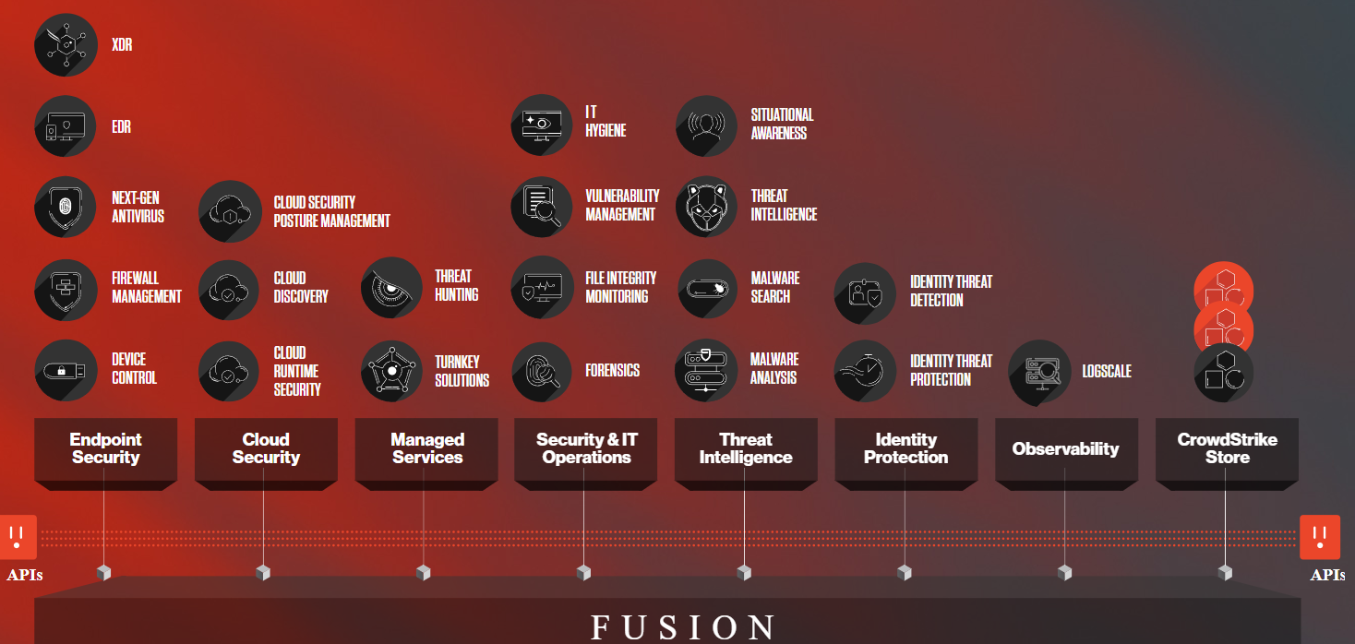
Crowdstrike Features
Technology team

Slide 9
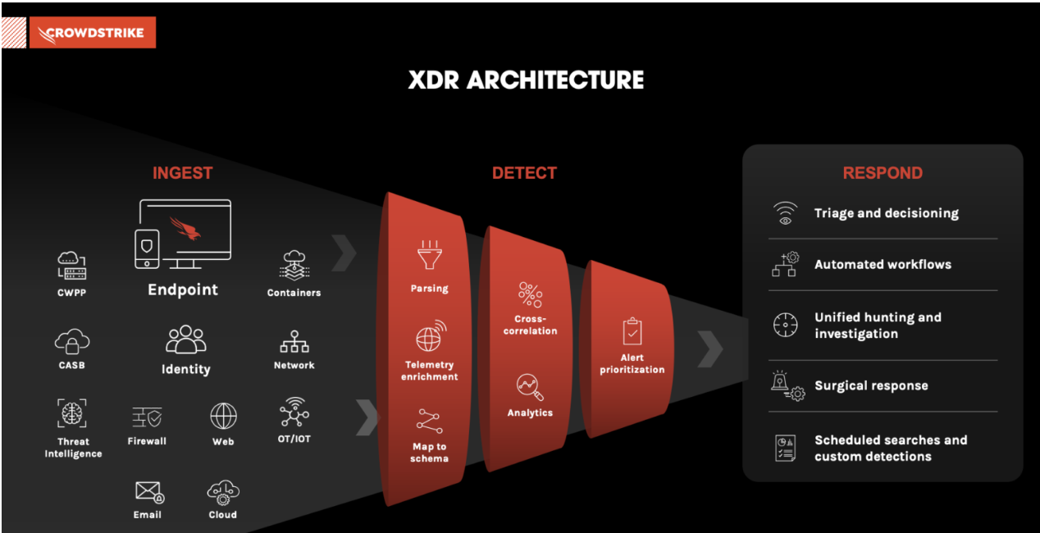
Crowdstrike Features (XDR Endpoint)
Step 1. Ingest: Ingest data from: cloud workloads, identity, email, network traffic, virtual containers and more.
Step 2. Detect: Parse and correlate data to automatically detect stealthy threats with advanced artificial intelligence (AI) and machine learning (ML).
Step 3 Respond: Prioritize threat data by severity so that threat hunters can quickly analyze and triage new events, and automate investigation and response activities.
Technology team

Slide 10
Investment Thesis
Investment Thesis to Sell CrowdStrike Stock:
While CrowdStrike has experienced strong growth and established itself as a leader in the cybersecurity market, there are several factors that warrant consideration for a sell recommendation.
Slowing revenue growth: Although CrowdStrike has demonstrated impressive revenue growth in the past, there are indications that the growth rate is slowing down. In the most recent fiscal year, the revenue growth rate was 82%, which is significantly lower compared to previous years. This declaration may be indicative of increased market saturation or intensifying competition.
Competitive landscape: The cybersecurity market is highly competitive, with many established players and new entrants constantly emerging. CrowdStrike's dominant market position could be challenged by competitors offering innovative solutions or gaining market share. This could potentially impact the company's growth prospects and market dominance.
Valuation concerns: While the growth potential of CrowdStrike is acknowledged, its valuation may already reflect the positive expectations. The stock may be trading at a high multiple compared to its earnings or revenues, which increases the risk of overvaluation. Investors should carefully assess the company's valuation metrics and consider whether the current stock price adequately reflects the future growth potential.
Profitability challenges: While CrowdStrike has shown improvements in its financial performance, achieving margin expansion and sustained profitability may prove challenging. As the company continues to scale its operations, there could be increased pressure on profitability due to rising costs, investments in research and development, and competitive pricing pressures.
Macroeconomic risks: The cybersecurity industry is not immune to macroeconomic factors that can impact business performance. Economic downturns or changes in government regulations and policies related to cybersecurity could affect the demand for CrowdStrike's services and impact its financial results.
Considering these factors, it is prudent to exercise caution and carefully evaluate the investment in CrowdStrike stock. Investors should weigh the potential risks and uncertainties against the company's growth prospects before making any investment decisions.

Slide 11
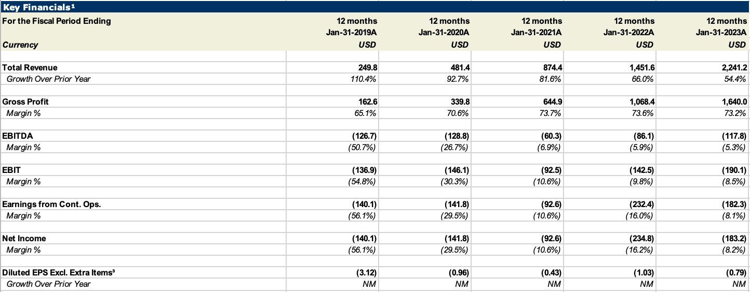
Financial Snapshot
The investment thesis for CrowdStrike (NASDAQ: CRWD) is based on the strong growth potential of the company in the rapidly growing cybersecurity market. Here are some key points to consider when evaluating the investment potential of CrowdStrike:
Strong revenue growth: CrowdStrike has demonstrated consistent revenue growth in recent years, driven by the increasing demand for cybersecurity solutions. In the fiscal year 2022, the company reported revenue of $1.47 billion, up 82% year-over-year. The company has a strong history of beating revenue estimates, which is a positive indicator for future growth.
Dominant market position: CrowdStrike is a leader in the endpoint security market, with a strong reputation for innovative technology and high-quality customer service. The company's flagship product, Falcon, is widely recognized as one of the best endpoint security solutions on the market. As the market for cybersecurity solutions continues to grow, CrowdStrike is well-positioned to capture a significant share of the market.
Growing addressable market: The global cybersecurity market is expected to continue growing rapidly in the coming years, as the threat of cyber attacks increases and businesses become more reliant on digital technology. This presents a significant growth opportunity for CrowdStrike, as the company continues to expand its product offerings and target new customer segments.
4. Strong financial position: CrowdStrike has a strong balance sheet, with over $2.4 billion in cash and investments as of the end of the fiscal year 2022. This provides the company with ample resources to continue investing in product development and expanding its market reach.
5. Potential for margin expansion: As CrowdStrike continues to scale its operations, there is potential for the company to achieve economies of scale and expand its profit margins. This could drive a significant upside for the stock over the long term.
Overall, the investment thesis for CrowdStrike is based on the company's strong growth potential in the rapidly expanding cybersecurity market, its dominant market position, and its strong financial position. While the stock may be subject to volatility in the short term, investors with a long-term horizon may benefit from holding shares of this innovative and growing cybersecurity company.

Slide 12
Q4 earnings overview
Solid 4Q beat - CRWD 4Q23 revenue and ARR of $637.4mm and $2.56bn respectively beat consensus estimates, both coming in ~2% above estimates. The quarter’s non-GAAP operating margin of 15.0% (16% for FY23) was
above consensus of 14.8%, while FCF of $209.5 also beat Street estimates. Reported net new ARR of $221.7mm rebounded after a somewhat muted ARR addition of $198.1mm in F3Q23. Performance was aided by contribution from public cloud ARR which reached $244mm in the quarter.
Guidance remains conservative - F1Q24 revenue guidance of $676.6mm at the midpoint was higher than consensus of $662.9mm, but the midpoint of FY24 revenue guidance ( $2.985bn) reflected more conservatism. Management reiterated “flat to slightly up” net new ARR guidance for FY24, mostly from expansion deals rather than new logos. Guidance for operating income implied margins of 16.6% at the midpoint, with 30% FCF margins (a benchmark already achieved), in spite of macro challenges expected to continue.
Metrics highlight efficiency - Net dollar retention improved y/y to 125% in the quarter, with a SaaS magic number of 1.1x, and the company continues to maintain the best LTV:CAC within the industry. Module adoption rates were revised to exclude the Falcon Go bundle, resulting in an upward revision of retention rate metrics for previous quarters of this year, by a few points. In the quarter, revenue at the bottom end of the market was surprisingly better, with better channel penetration, in contrast to low end weakness seen in Q3. This also contrasts trends we have seen with other companies across software markets this quarter, which have cited SMB weakness. Net new logo growth was healthy at 41% y/y, with penetration across all regions and markets, while ARR per customer increased for the fourth consecutive quarter by 3.8% y/y, driven by another quarter of better module attach rates.

Slide 13
Growth Catalysts
Increasing demand for cybersecurity solutions: The global cybersecurity market is expected to continue growing rapidly in the coming years, as the threat of cyber-attacks increases and businesses become more reliant on digital technology. As a leading provider of endpoint security solutions, CrowdStrike is well-positioned to benefit from this trend.
Expansion into new markets and customer segments: CrowdStrike has been successful in expanding its product offerings and targeting new customer segments, such as small and medium-sized businesses (SMBs) and government agencies. These efforts have the potential to drive significant growth for the company over the long term.
Partnerships and strategic alliances: CrowdStrike has formed strategic partnerships with a number of other companies in the cybersecurity space, including Okta, Google, and AWS. These partnerships help to expand the company's market reach and drive new customer acquisitions.
Innovations in technology: CrowdStrike is known for its innovative technology, which includes the use of artificial intelligence and machine learning to detect and prevent cyber-attacks. The company continues to invest in research and development to stay ahead of emerging threats and maintain its competitive edge in the market.
Strong customer retention: CrowdStrike has a strong track record of customer satisfaction, with a net retention rate consistently above 120%.

Slide 14
SWOT Analysis
Strength:
Opportunities:
Leading position in the rapidly growing endpoint protection market
Strong brand recognition and reputation in the cybersecurity industry
Comprehensive and innovative product portfolio with a competitive advantage
Large and growing customer base, including many Fortune 500 companies
Strong financial position with steady revenue growth and profitability
Dependence on a few key customers for a significant portion of revenue
Relatively high pricing compared to some competitors Limited presence in some international markets
Potential for integration issues with other cybersecurity solutions
Growing demand for cloud-based and AI-powered cybersecurity solutions
Increasing awareness of the need for stronger endpoint protection
Potential to expand into adjacent markets, such as threat intelligence and incident response
Growing need for cybersecurity services in emerging markets
Potential for strategic partnerships and acquisitions to expand product portfolio and customer base
Intense competition from established players and new entrants in the endpoint protection market
Increasingly sophisticated and evolving cyber threats and attacks
Dependence on third-party vendors and suppliers for critical components and services
Potential for economic downturn or decreased IT spending affecting cybersecurity market growth.
Weakness:
Threats:

Slide 15
SWOT Analysis
Strengths
Weaknesses
S
W
Industry Leader
Rapidly Growing Client Base
Consistent Profitability
Resilient Business Model
Limited International Presence
High Pricing
Integration Issues
O
T
Opportunities
Threats
Increasing Competition
Sophisticated Cyber Threats
Product Dependence
Resilient Demand
Rapidly Expanding TAM
AI Advancement and Adoption

Slide 16
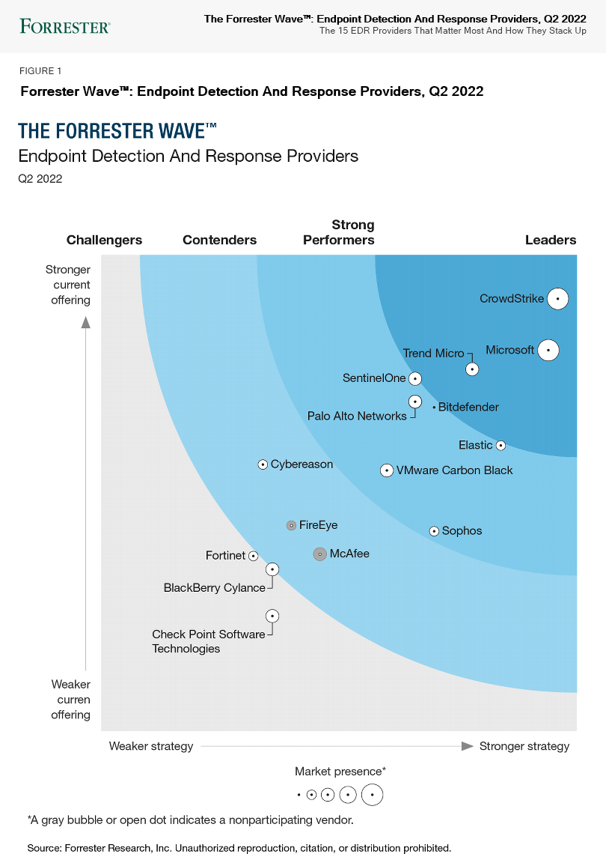
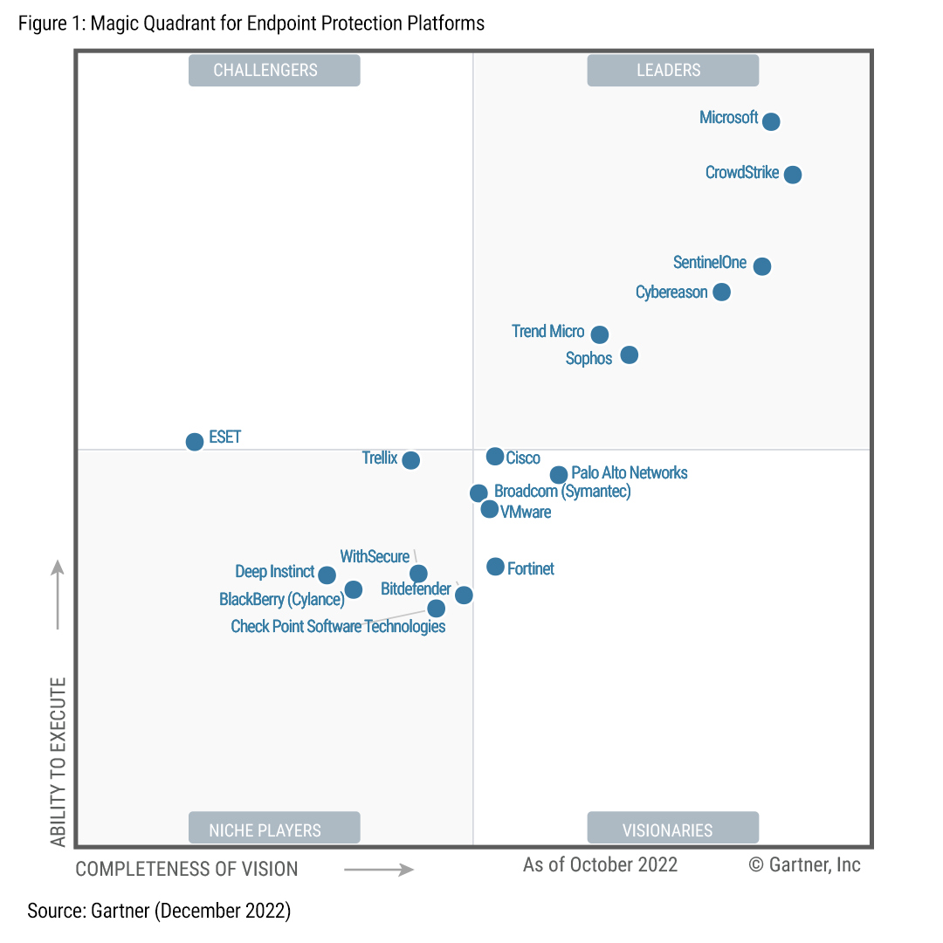
Competitor Analysis

Slide 17
Risks and Mitigants
01
Markets pricing in possible slowdown in growth and valuation still offers discount
Risks associated with managing CrowdStrike’s rapid growth
02
Robust growth in client base and rapid expansion in product portfolio
Increasing competition from established players and new entrants in the endpoint protection market
03
Security remains business critical and spending can be delayed but cannot be avoided
Potential for economic downturn or decreased IT spending affecting cybersecurity market growth

Slide 18
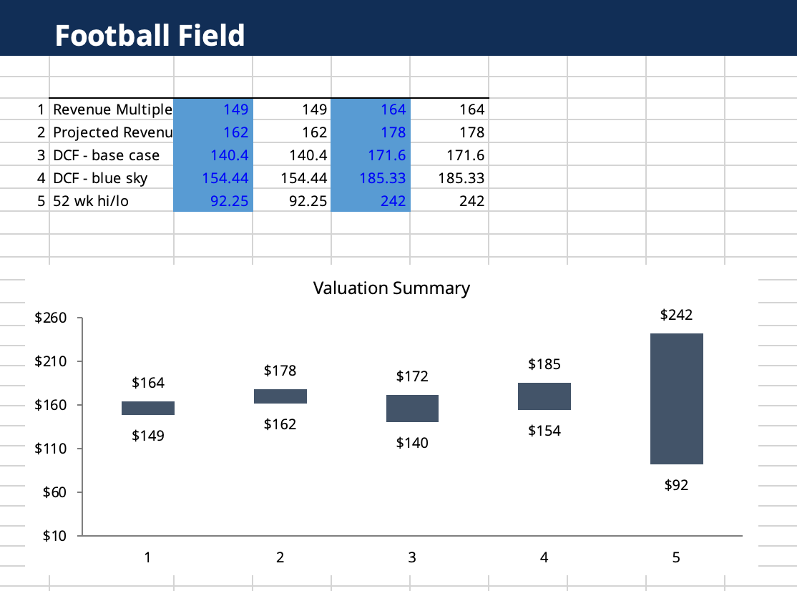
Valuation Summary

Slide 19
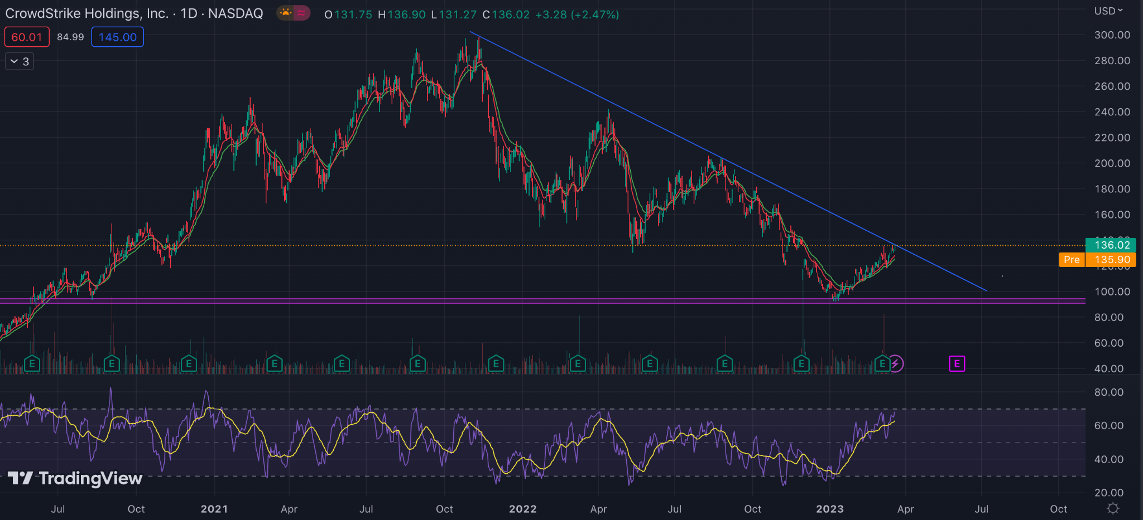
Technical pattern- Crowdstrike
Stock has been falling since 2021 November
Recently breached the downward trendline
Took support at $90 which is a long term support
30% up from low
Daily RSI at 66 level and rising

Slide 20
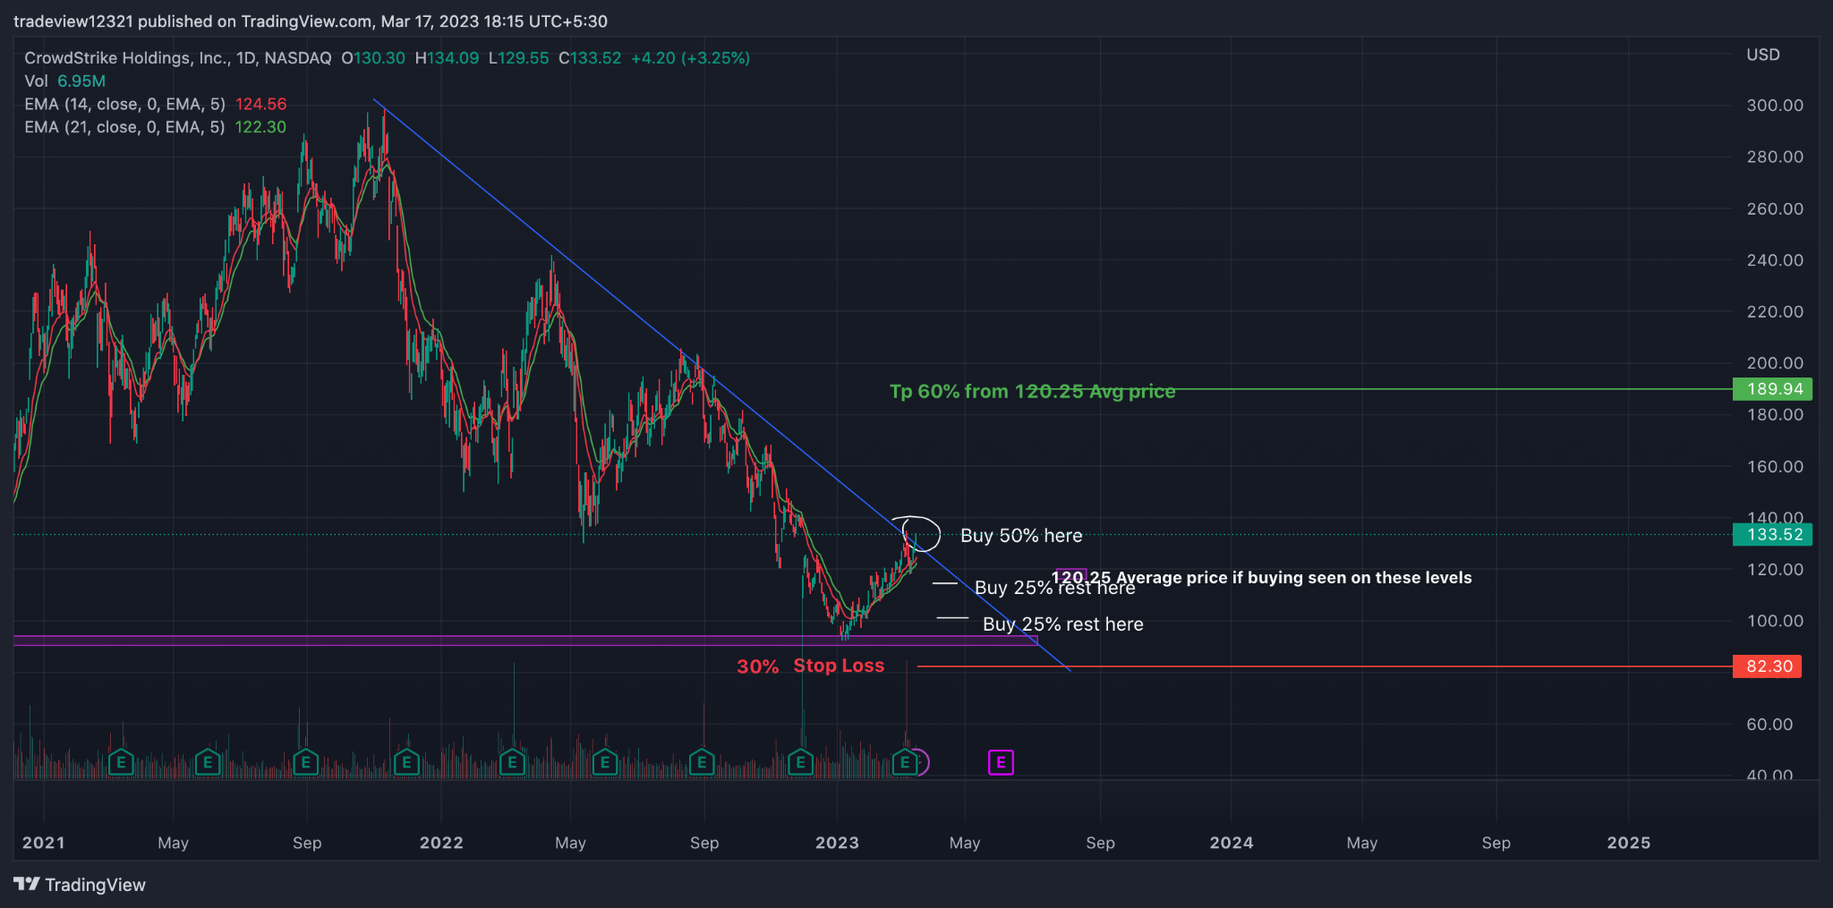
1st Trading style
Buying stock in multiple quantities and hedging the risk with selling calls
50% qty bought at current breakout level of $133
25% at 119 (15% drop)
25% at 100 (15% drop)
$120.25 avg price
SL: $83 (30% low from Avg)
TP: $193 (60% from Avg)

Slide 21
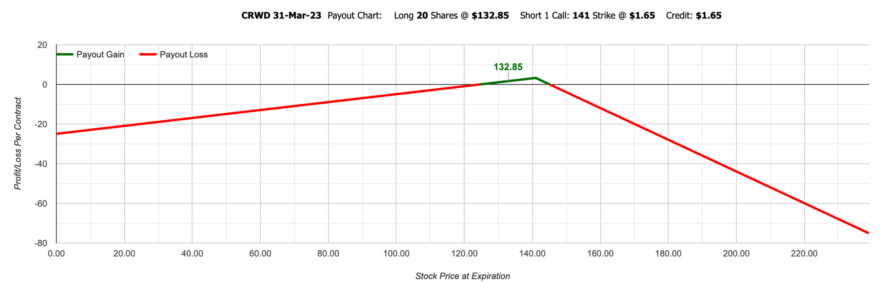
Option payout chart: Hedging Strategy
Selling 1 call option $10 higher from CMP
We are saved till $124.63. Break even point on lower side
Till $145 expiry of option we are saved and it’s the breakeven on the higher side
Max profit: $318 (@ $140.50)
Only monthly expiries we work on on, make position around 2 weeks from expiry

Slide 22
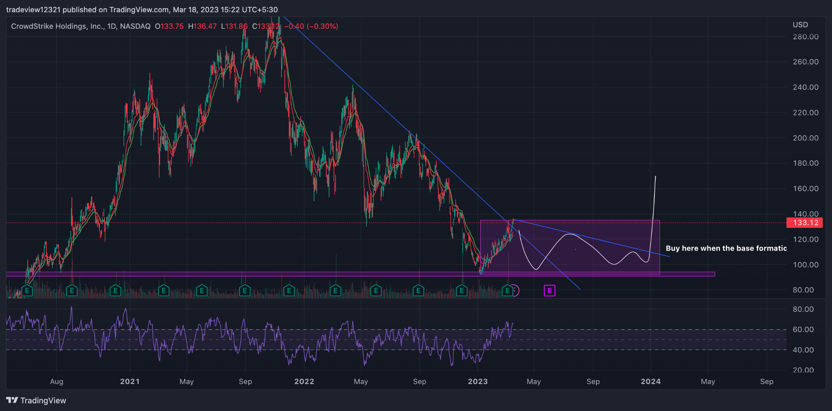
2nd Trading style (Preferred)
Base formation Strategy
Buy stock when breaking either the rectangle or a new trendline it makes
100% or marginal stock buy at levels
SL: Below support of $90 (Lower risk), Max $10 below $90
TP: 1:2 depending on entry (minimal)
Hedge the stock with selling calls same as Strat 1 to earn premium decay, (only if required)

Slide 23

QUESTIONS

